Slide 1
Design Practice

Slide 2
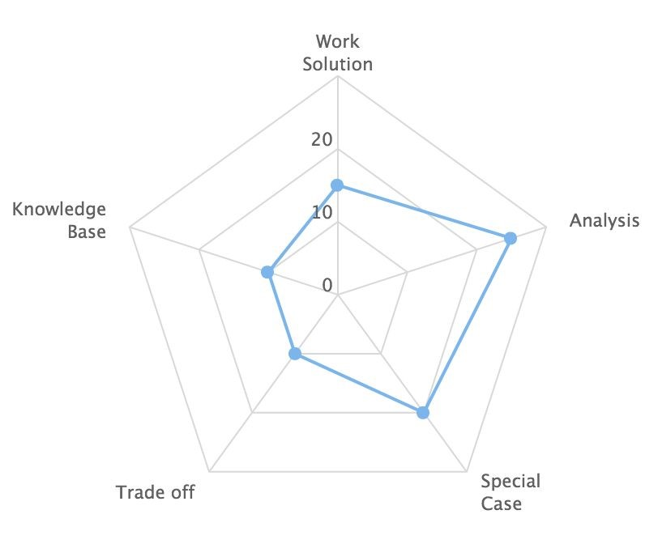
How you are evaluated in the Design Interview?

Slide 3
What is your steps
Clarify scenarios.
Component design
OOP design
Data model design
Choose data system,
Trade off between scalability or consistency
Scalability and fault tolerance
Performance Enhancement
Special algorithm
API Design
Stateless or Stateful?

Slide 4
Scenario, Service, Storage, Scale
Scenario
Ask / Features / Scale / Interfaces / Data
Service
Split big system into small components
Storage
Schema / Data / SQL / NoSQL / File System
Scale
Sharding / Cache / Optimize

Slide 5
Component Design

Slide 6
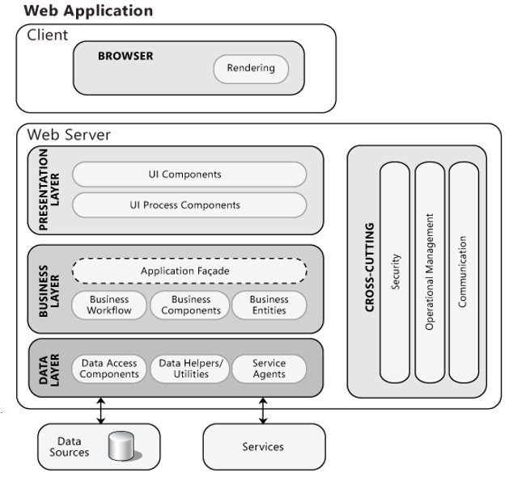
Common Web Architecture

Slide 7
Component Design
Differentiate Web Server and Business logic
Application Server.
Each component module has to be independent
Think services, not just web server
How the components or services work together
Synchronous API or Asynchronous work flow.

Slide 8
Component Design
Differentiate Web Server and Business logic
Application Server.
Each component module has to be independent
Think services, not just web server
How the components or services work together
Synchronous API or Asynchronous work flow.

Slide 9
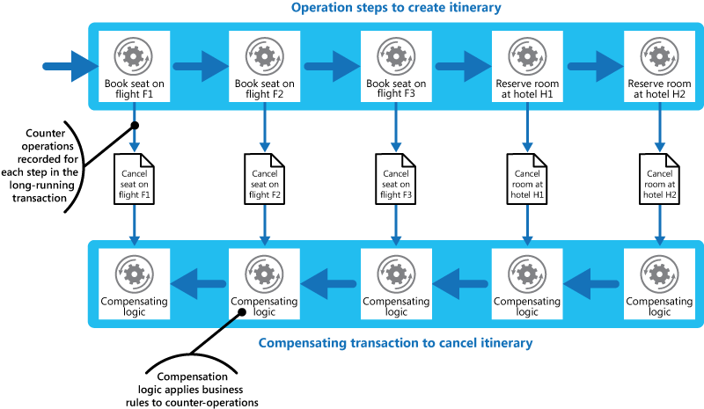
A typical workflow

Slide 10
Two typical asynchronous patterns
Shared Spaces with Finite State Machine
Producer and consumer queue

Slide 11
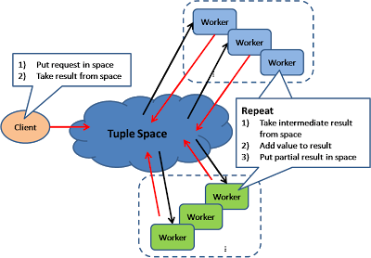
Shared Space with FSM
This model also known as "Blackboard"; all workers monitors information from the shared space and contributes partial knowledge back to the blackboard. The information is continuously enriched until a solution is reached. The objects in the shared space may have states, the worker may process the object when the state is satisfactory and set the state for the next step

Slide 12
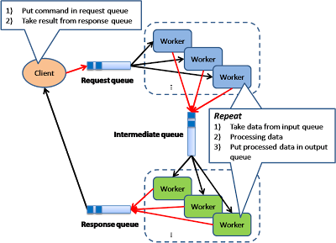
Pipe and Filter
This model is also known as "Data Flow Programming"; all workers connected by pipes where data is flow across. This pattern is a very common EAI pattern.

Slide 13
OOP and Data Model

Slide 14
OOP design
This step happens in the Application layer or Business logic layer
A easy tips
All nouns are classes, all verbs are method, all attributes are private members.
How the objects are created? Object factory?
Singleton Object creation?

Slide 15
Data Model Design
Entity and Relation
Both entity and relation can be a table
What is primary key, what is secondary key
What are the common search and update pattern?
How do you build index?
Cluster index and non cluster index?

Slide 16
Data System Choice
Do you need strong data consistency?
If yes, RDBMS is your answer.
Do we have heavy join?
If yes, RDBMS or Data warehouse, data cube.
Is this a batch processing?
Map reduce is a batch processing.
Is this a data stream pipeline?
IOT, data sampling based on sensors. Service Bus, Event Hub, Kafka
Is this a key value access store?
Normally return a object or a set of objects, not row set
Do we need sparse columns?
Cassandra

Slide 17
Scalability and Fault Tolerance

Slide 18
Scalability
How to partition your process node?
Consistent Hash
How to partition your data?
Sharding
Centralized meta data or completely distribute system?
Scalability vs Consistency
CAP theory

Slide 19
Idempotence

Slide 20
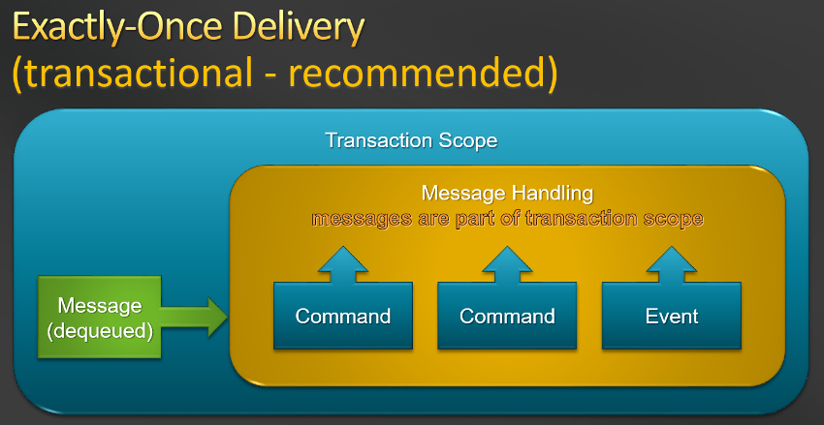
Idempotence
Idempotence is the property of certain operations in mathematics and computer science whereby they can be applied multiple times without changing the result beyond the initial application.

Slide 21
Linearizability

Slide 22
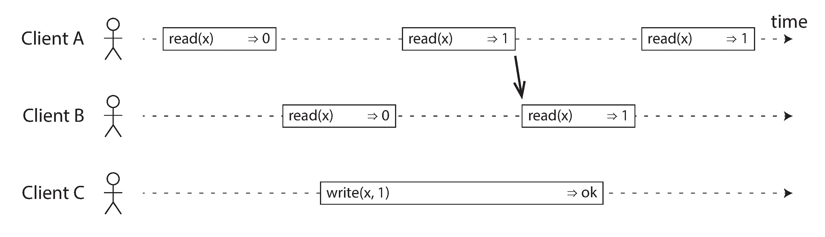
Linearizability
The basic idea behind linearizability is simple: to make a system appear as if there is only a single copy of the data.
In a linearizable system we imagine that there must be some point in time (between the start and end of the write operation) at which the value of x atomically flips from 0 to 1. Thus, if one client’s read returns the new value 1, all subsequent reads must also return the new value, even if the write operation has not yet completed.

Slide 23
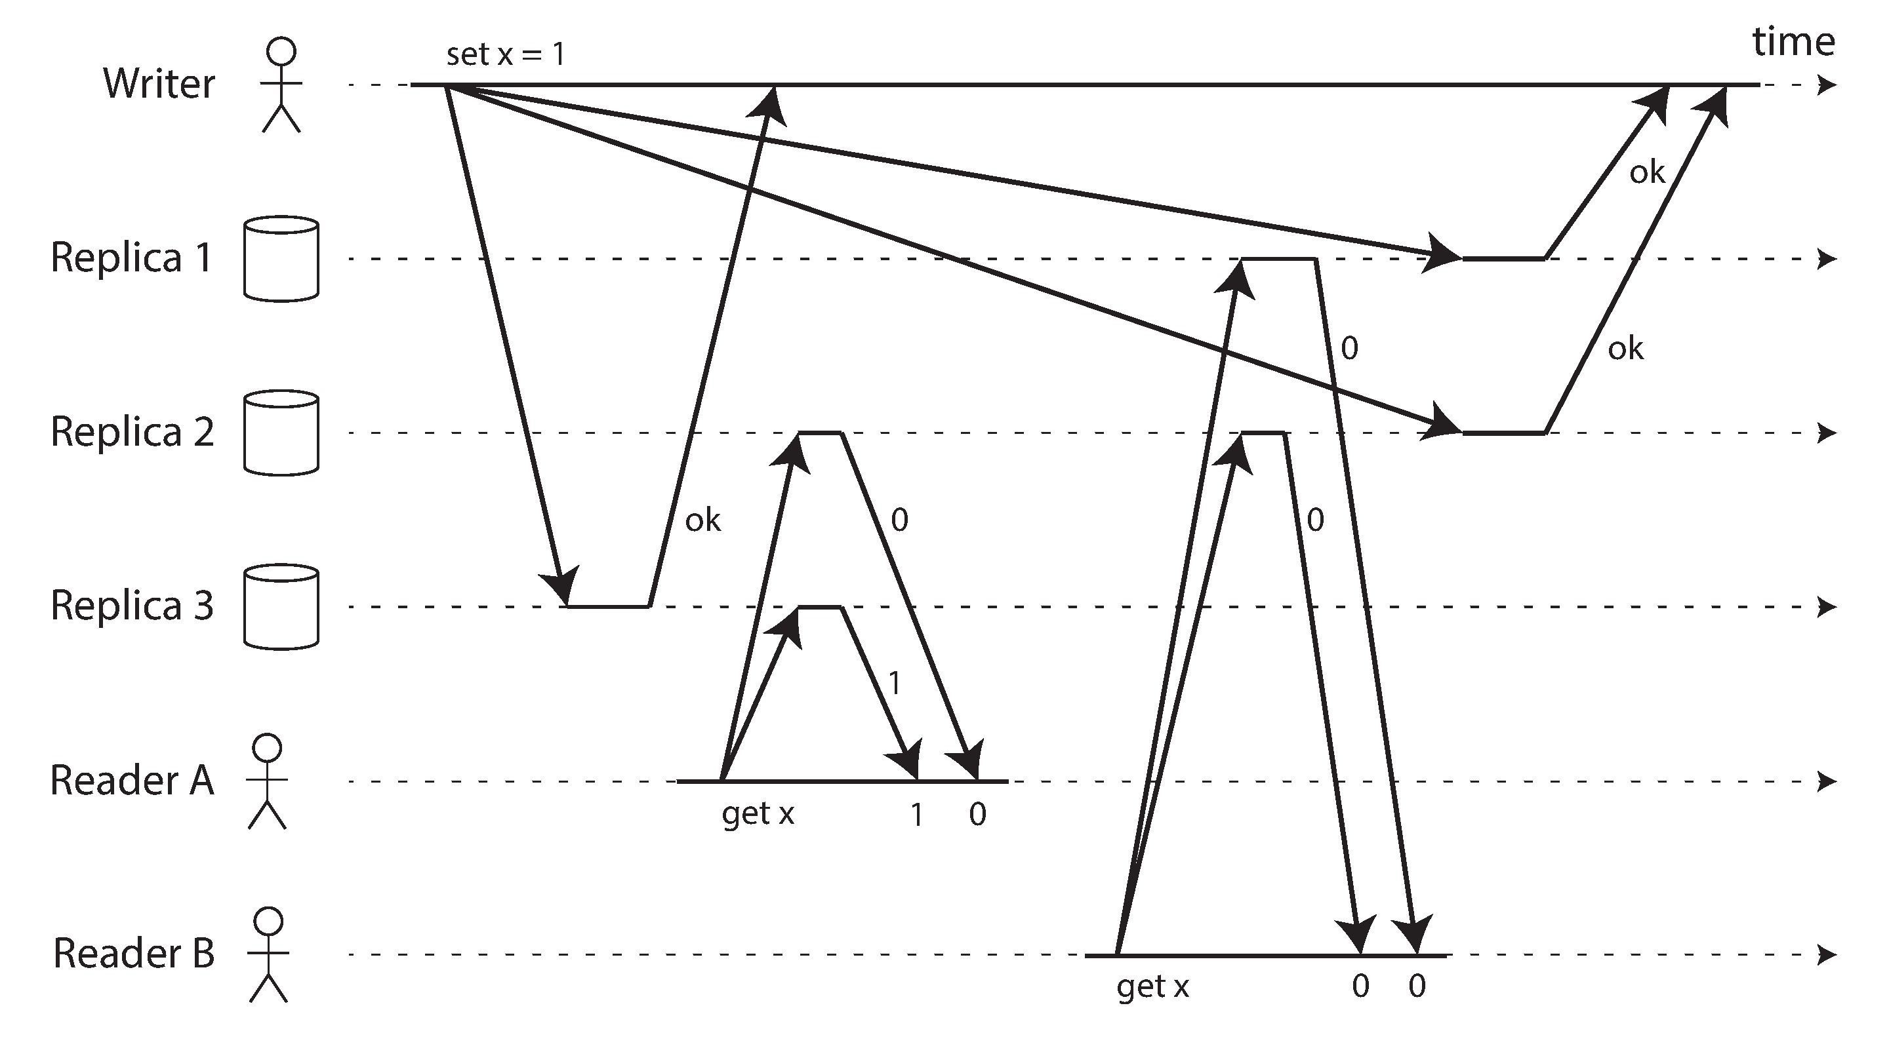
Implementing Linearizable Systems
Single-leader replication (potentially linearizable)
Consensus algorithms (linearizable)
Multi-leader replication (not linearizable)
Leaderless replication (probably not linearizable，even with quorum)

Slide 24
Performance Optimization

Slide 25
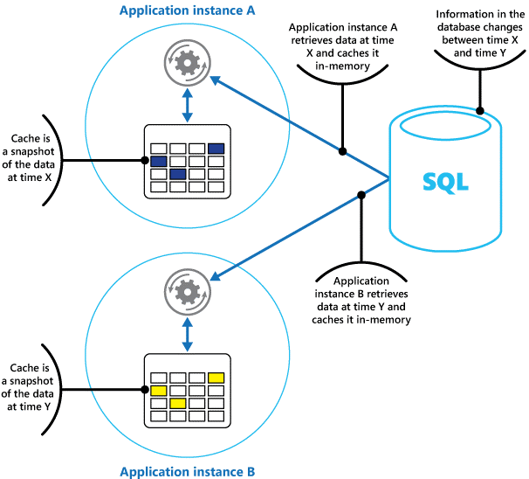
Private Caching

Slide 26
Algorithm and Strategy

Slide 27
Critical Challenge
You are expect to predict the most challenge problem in the system based on the scenario.
You need to design the strategy and algorithm to resolve the challenge.
But before you start, you can define user scenario and workflow to make your life easy.
Let’s look at some real examples and see what are the most challenge issues.

Slide 28
Design Uber

Slide 29
Design Uber
How do you locate rider and driver?
How do you calculate the ETA for a driver to reach you?
How do you calculate the fares?

Slide 30
Design Uber
Think about how do you describe the map?
A driver goes by road, which is similar to Manhattan distance, not directly distance.
The travel time can be accumulated by the road time, and the road time can be calculated either by the car speed pass the sensor or by tracking other drivers.
Geo hash can help you to calculate the most close driver or customer but you need to think road above.

Slide 31
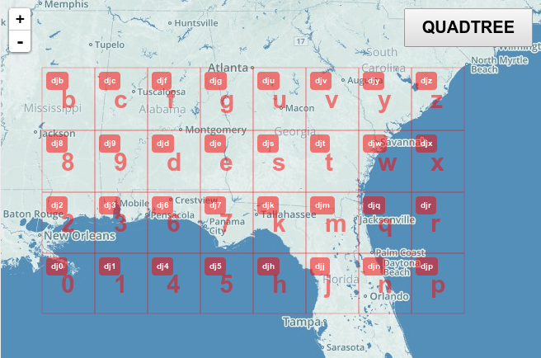
Geo hash
Use binary divide the global geo location.
Smaller location have more bits.
Adjacent location has only 1 bit different.

Slide 32
Design Netflix

Slide 33
Design Netflix
Video Delivery
Make the content close to the player -- CDN
Progressive playback
Make the video as small clips and store it in read only data store. EC2, S2, live streaming
Content Management and DRM
Control your copy right
Adaptive broadcasting
Adjust video quality based on bandwidth
Cross- device delivery
Payment
Recommandation

Slide 34
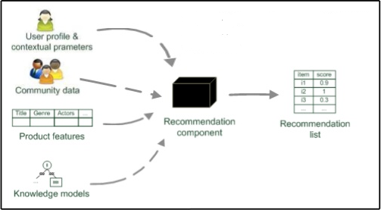
Paradigms of recommender systems
Personalized recommendations
Collaborative: "Tell me what's popular among my peers“
Content‐based: "Show me more of the same what I've liked“
Knowledge‐based: "Tell me what fits based on my needs"

Slide 35
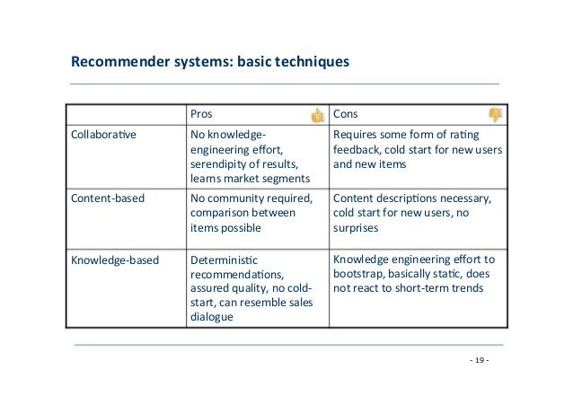

Slide 36
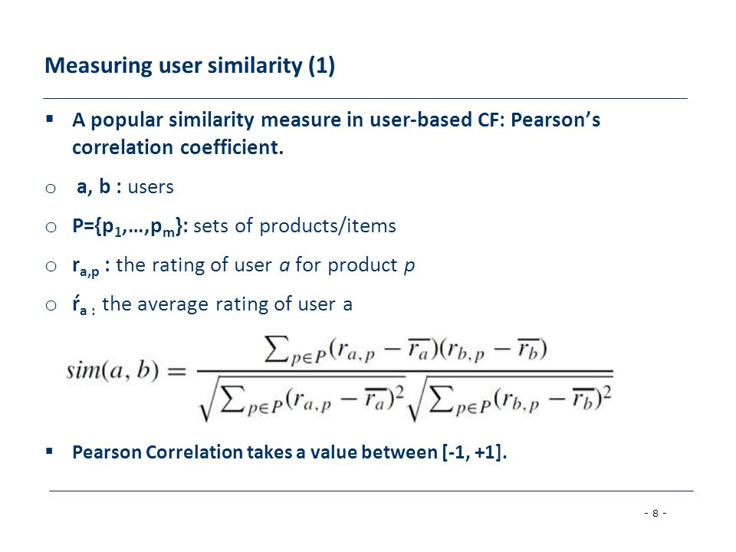

Slide 37
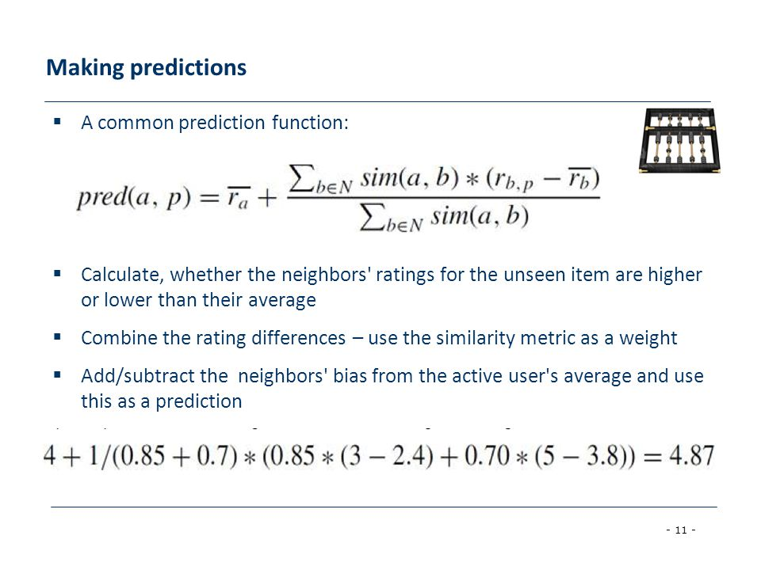

Slide 38
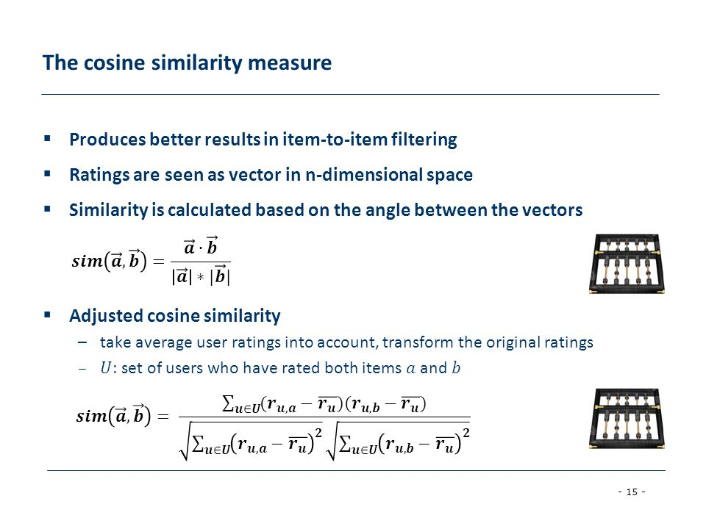

Slide 39
Design Facebook

Slide 40
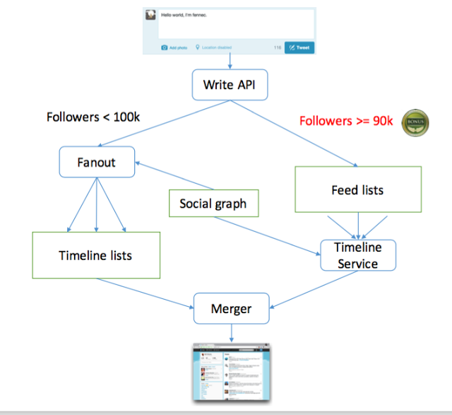
Facebook news feed and Timeline

Slide 41
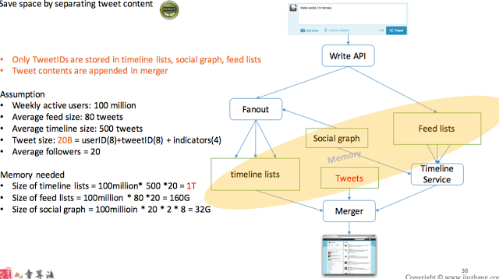
Tweeter

Slide 42
Design a unique ID with time order in cloud

Slide 43
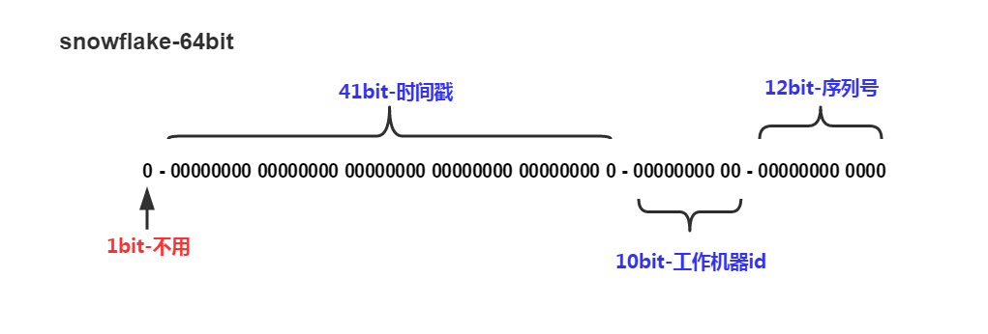
Twitter-Snowflake 64 bits mono-increasing unique id

Slide 44
Something like we chat

Slide 45
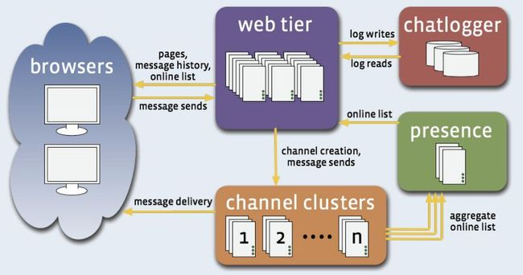
Facebook Erlang
Entity: User, message, channel, friend list.
Public channel is almost like a news feed.
Monotonic read consistency.
SQL for user management and friend list
Non-SQL, such as Kafka for channel or messages.

